Slide 1
9. Publishing and Linked Open Data
John P. McCrae
CT5166

Slide 2
Course structure
9th Sep | Introduction to Knowledge Graphs | 21st Oct | Inductive reasoning
16th Sep | Models for Knowledge Graphs | 28th Oct | KG Creation (no lab on Monday)
23rd Sep | Querying and Serialization | 4th Nov | KG Alignment
30th Sep | Schemas | 11th Nov | Publishing and Linked Open Data
7th Oct | Deductive reasoning | 18th Nov | Linguistic Linked Open Data
14th Oct | No Lecture | 25th Nov | Enterprise Knowledge Graphs

Slide 3
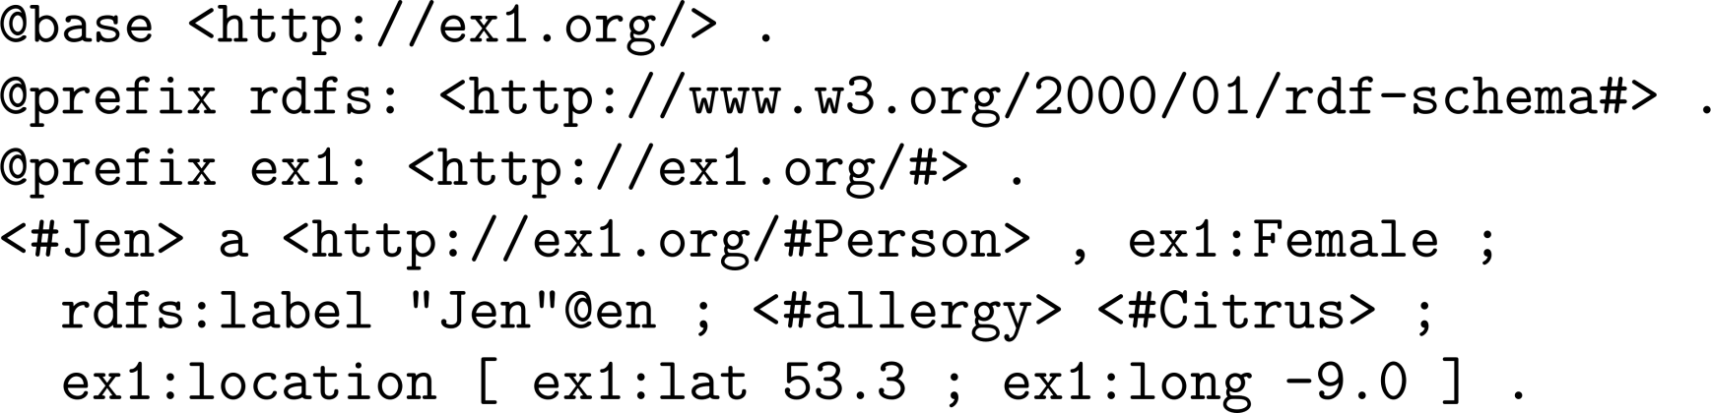
RDF is full of IRIs

Slide 4
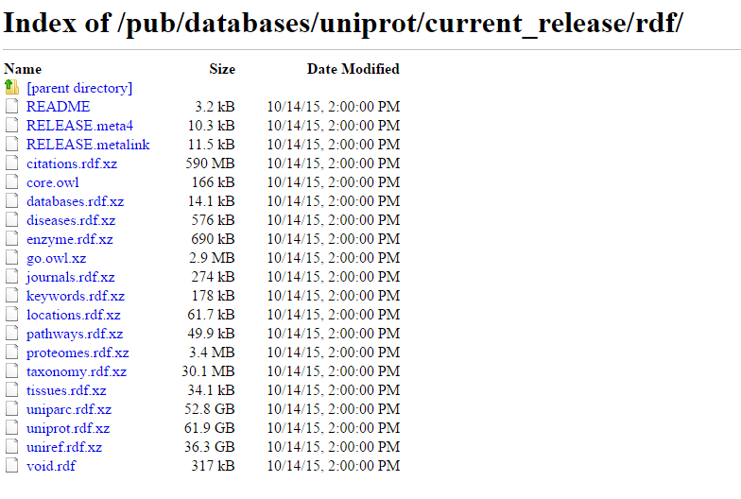
Lots of RDF datasets

Slide 5
But is this linked data?

Slide 6

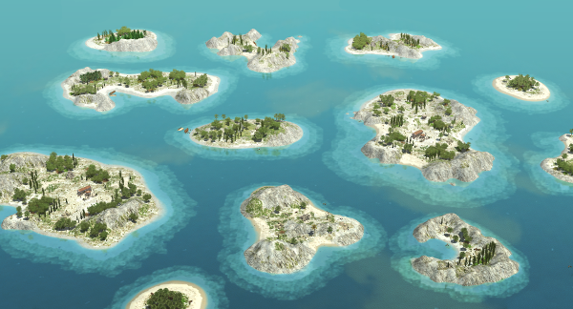
…. or islands of RDF data?

Slide 7
FAIR data
FINDABILITY: metadata, identifiers, registered and indexed
ACCESSIBILITY: standards, separation of metadata
INTEROPERABILITY: common vocabularies, references
REUSABILITY: license, provenance
Notes:
NEW

Slide 8
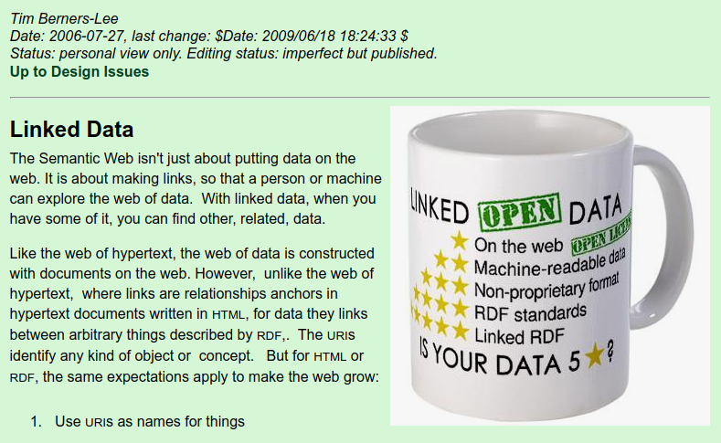
Linked data principles
https://www.w3.org/DesignIssues/LinkedData.html

Slide 9
Principle 1: Use URIs to name things
Universal and globally unique
Can be used for more information
Well understood standard

Slide 10
Principle 2: Use HTTP URIs so that people can look up those names.
HTTP is a standard protocol
Domain name shows who ‘owns’ the URL
Accessible in a Web browser

Slide 11
Principle 3: When someone looks up a URI, provide useful information, using the standards
Web pages?
RDF documents?
SPARQL endpoints?

Slide 12
Principle 4: Include links to other URIs. so that they can discover more things.
Reuse URIs.
Fight ‘Not Invented Here Syndrome’
Value and recognise others’ work
‘Giant Global Graph’
Notes:
NIH Syndrome: A tendency for companies/institutions to avoid products that they didn’t invent themselves, and the belief that in-house products are always better. This leads to diverging standards.

Slide 13
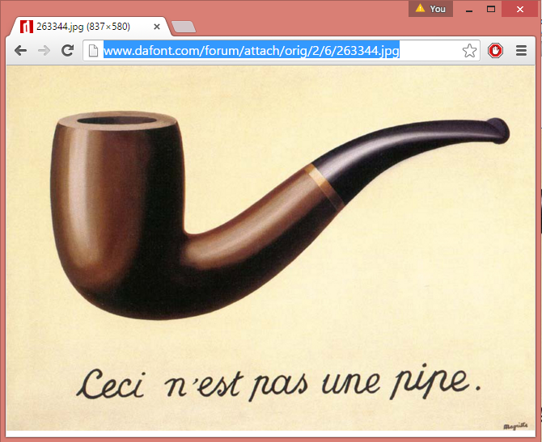
A slight catch...
HTTP URIs represent documents, not things

Slide 14

Multiple HTTP URLs / one real-world concept
Human-readable page
http://www.example.com/pipe.html
RDF (machine-readable) version
http://www.example.com/pipe.rdf
RDF version but in Turtle
http://www.example.com/pipe.ttl
SPARQL endpoint
http://www.example.com/query?DESCRIBE+...

Slide 15



Content Negotiation
http://www.example.com/pipe.html
Humans
Single URL
http://www.example.com/pipe
http://www.example.com/pipe.rdf
Machines
http://www.example.com/pipe.ttl
Turtles

Slide 16


Content Negotiation
GET /pipe HTTP/1.1
Accept: application/rdf+xml
HTTP/1.1 303 See Other
Location: /pipe.rdf
GET /pipe.rdf HTTP/1.0
HTTP/1.1 200 OK
<rdf:RDF …

Slide 17

Content Negotiation
GET /pipe HTTP/1.1
Accept: text/html
HTTP/1.1 303 See Other
Location: /pipe.html
GET /pipe.html HTTP/1.0
HTTP/1.1 200 OK
<!DOCTYPE HTML> …

Slide 18
Task
What happens when you go (in your browser) to
http://dbpedia.org/resource/Pipe?
Try to browse with curl. Can you get a page in Turtle?
curl -v -L -H "Accept: application/rdf+xml" http://dbpedia.org/resource/Pipe
NB.
-v = verbose output; shows request and response headers
-L = follow redirects
-H = set headers

Slide 19
Linked Closed Data?
Many closed datasets refer to open data
Referring to closed datasets does not satisfy Principle 4
Linked Data
=
Linked Open Data?

Slide 20
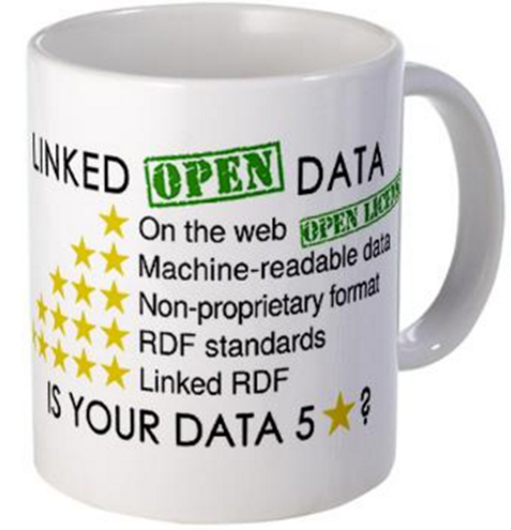
5 Stars of Linked Open Data
★ Publish data under open licence
★★ Make the data “machine readable”
e.g., a Spreadsheet better than a PDF table
★★★ Use non-proprietary formats
e.g., a CSV text file better than Excel
★★★★ Use URIs to name your stuff (hint: RDF)
use unambiguous identifiers that can be linked/looked up
★★★★★ Provide links to other content
so consumers can follow links to find out more

Slide 21
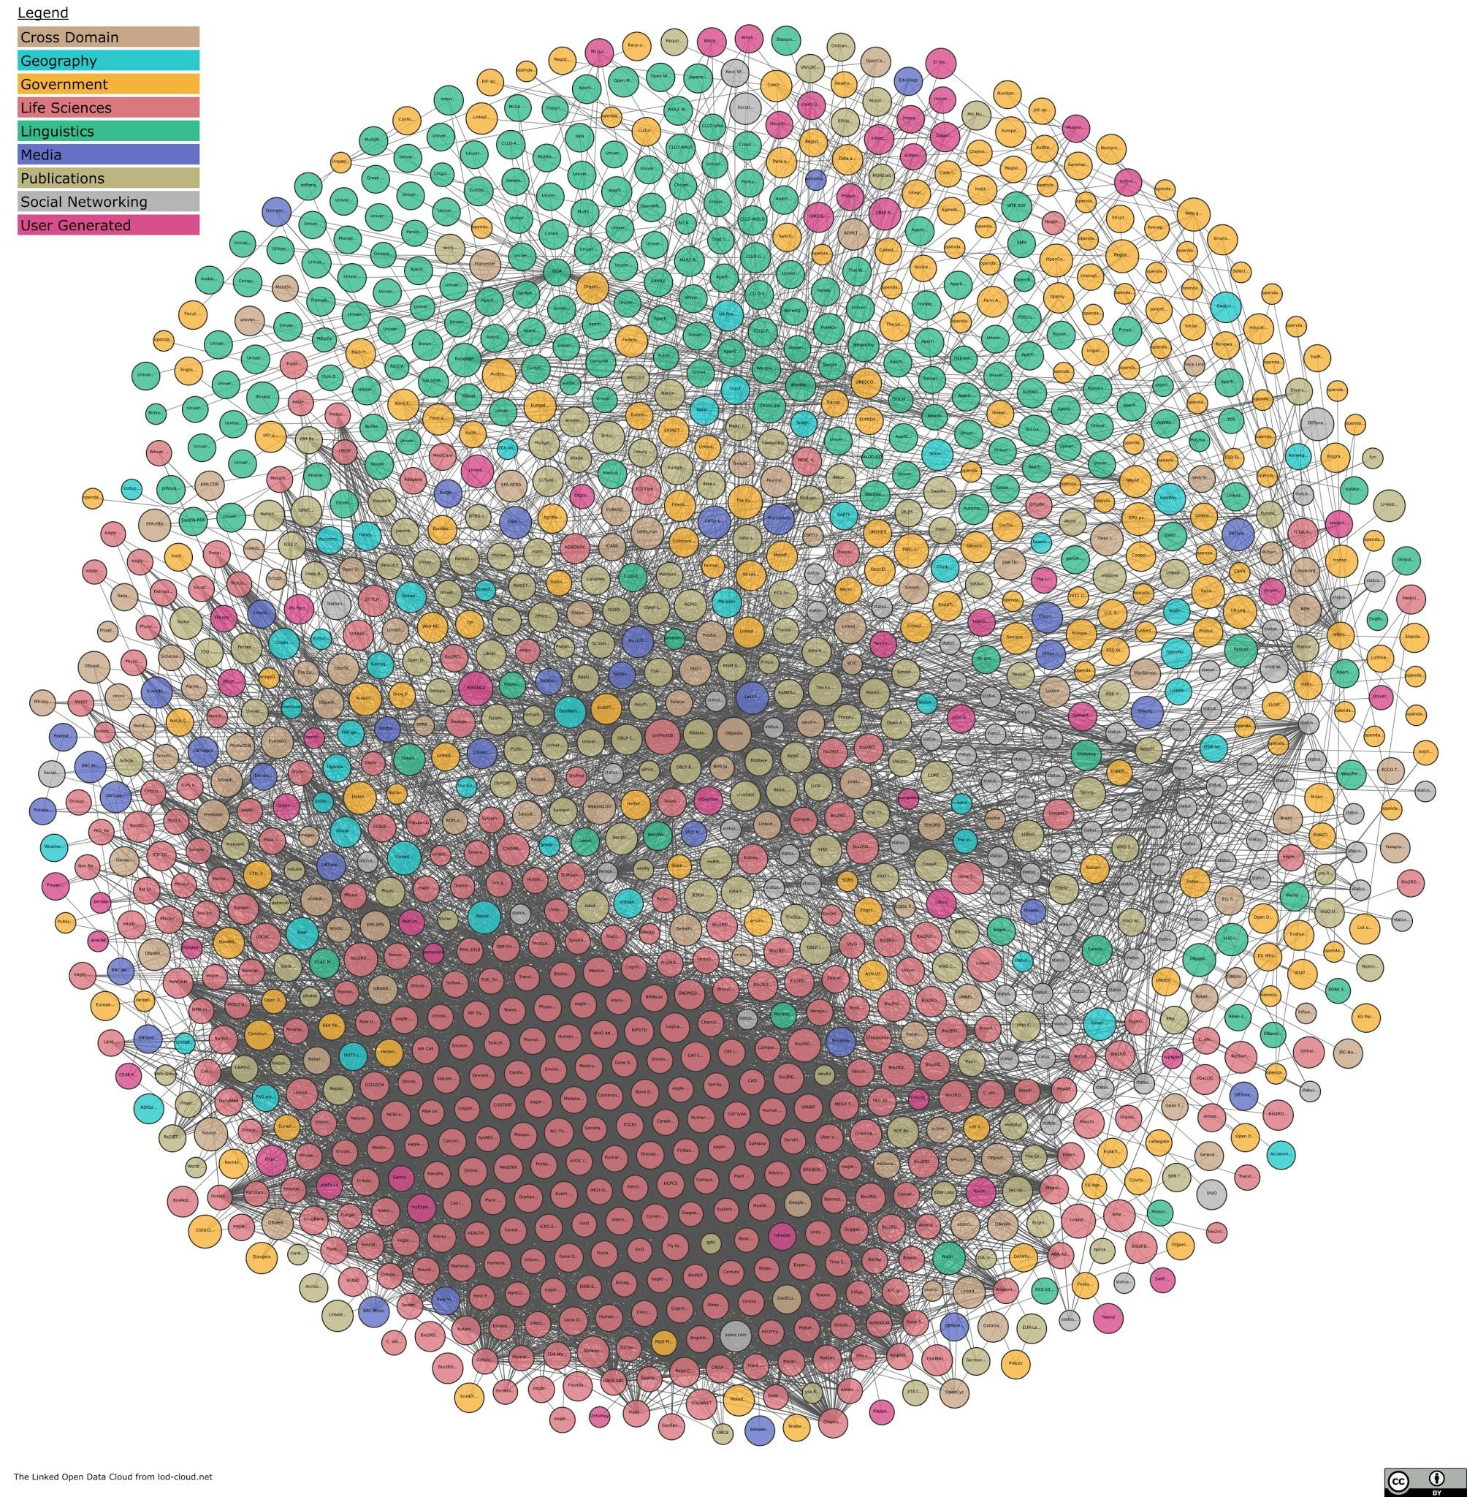
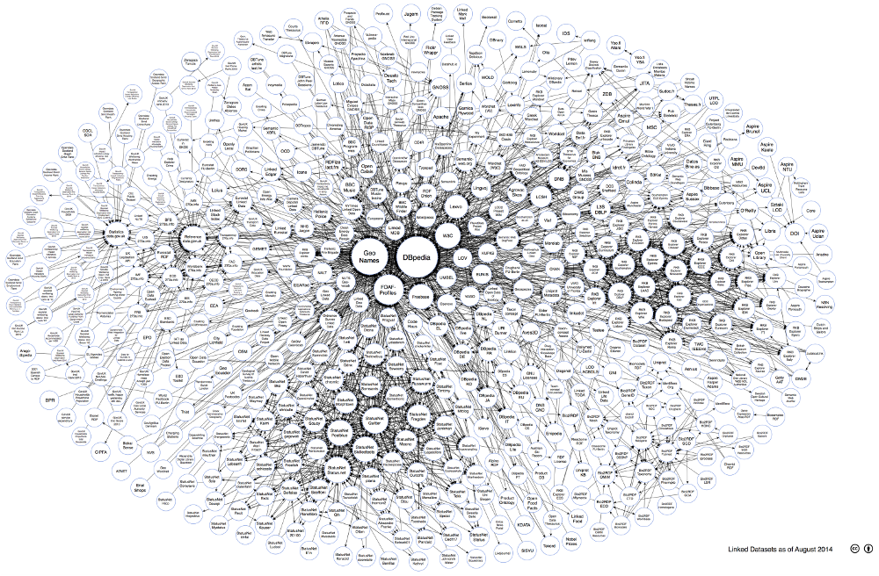
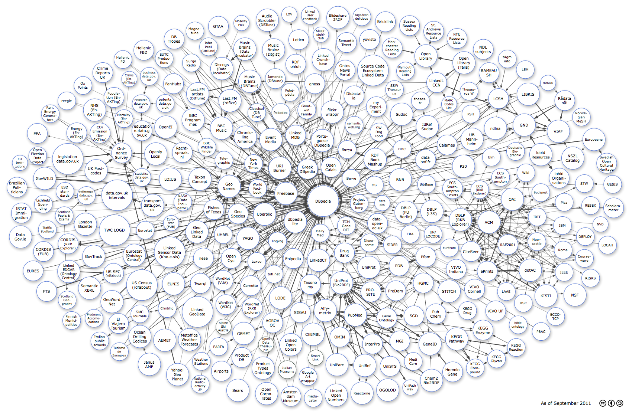
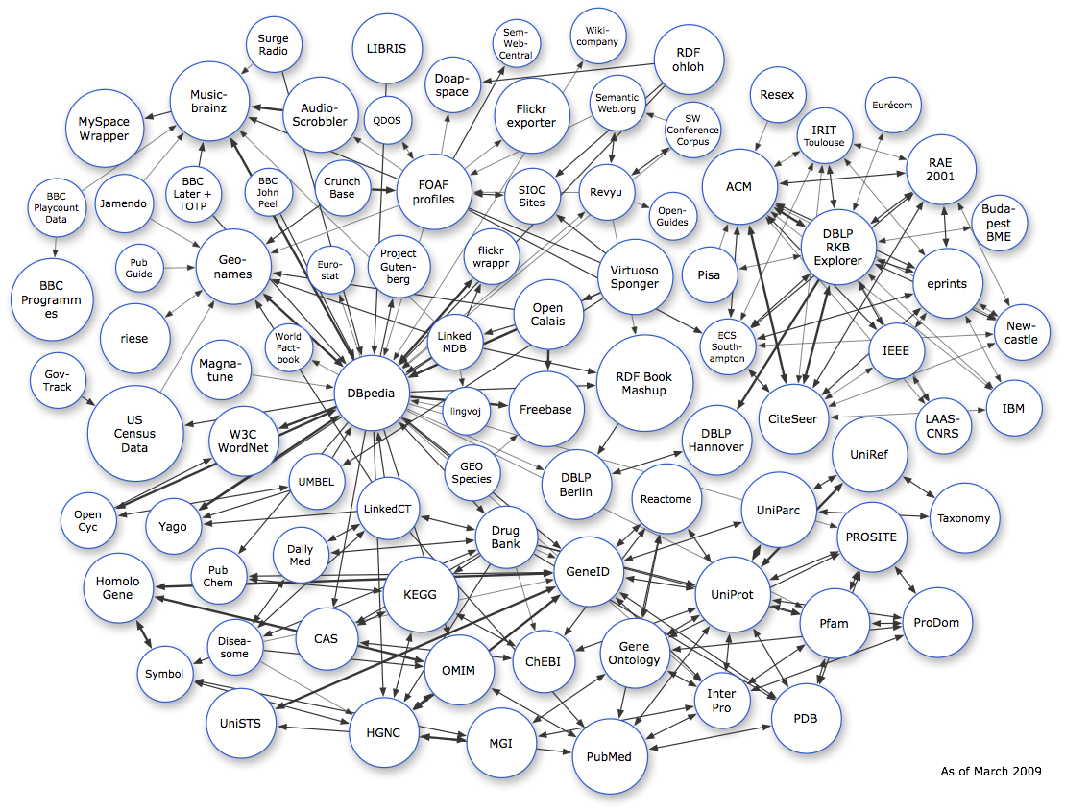
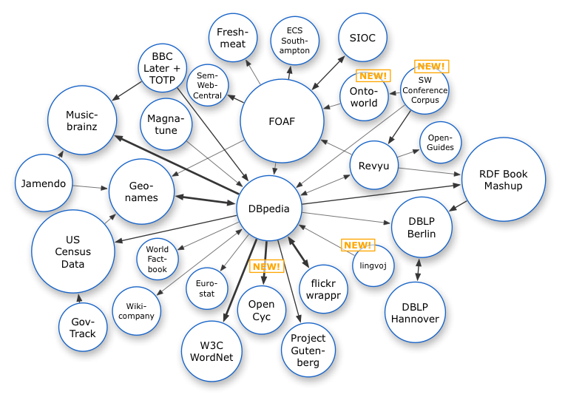
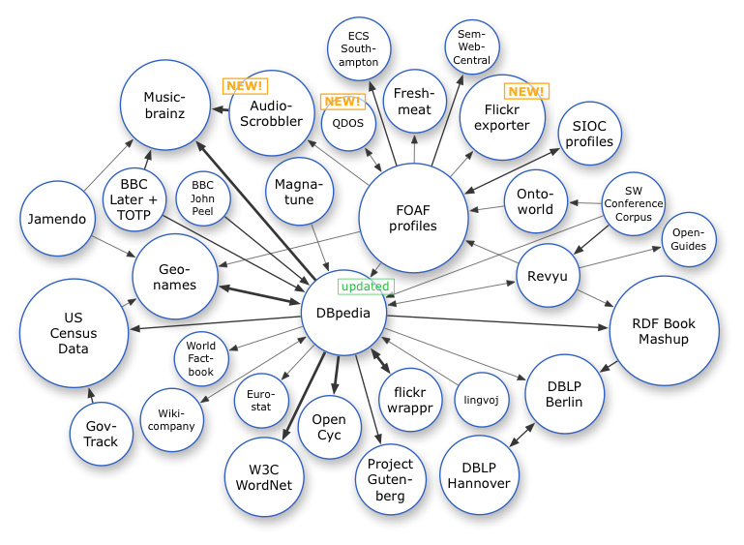
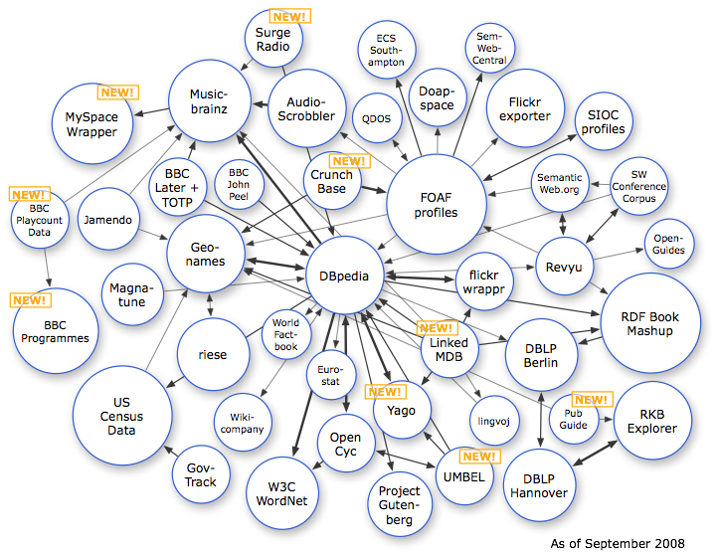
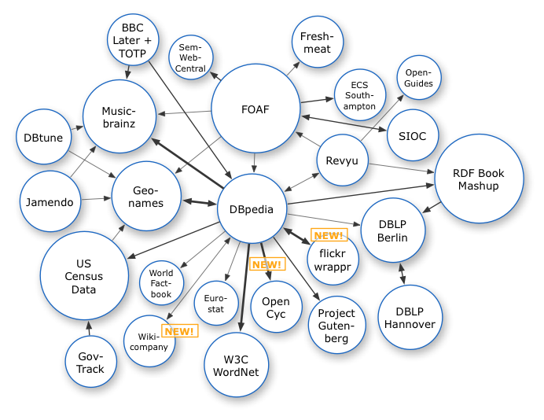
Growth of Linked Data
Oct 2007
Nov 2007
Feb 2008
Sep 2008
Mar 2009
Sep 2011
Aug 2014
Nov 2020

Slide 22
Some Linked Data Datasets

Slide 23


DBpedia
Encyclopedic resource mostly extracted from Wikipedia

Slide 24

Wikidata
Large graph of facts about everything
From same organization as Wikipedia (and closely related to Wikipedia)

Slide 25
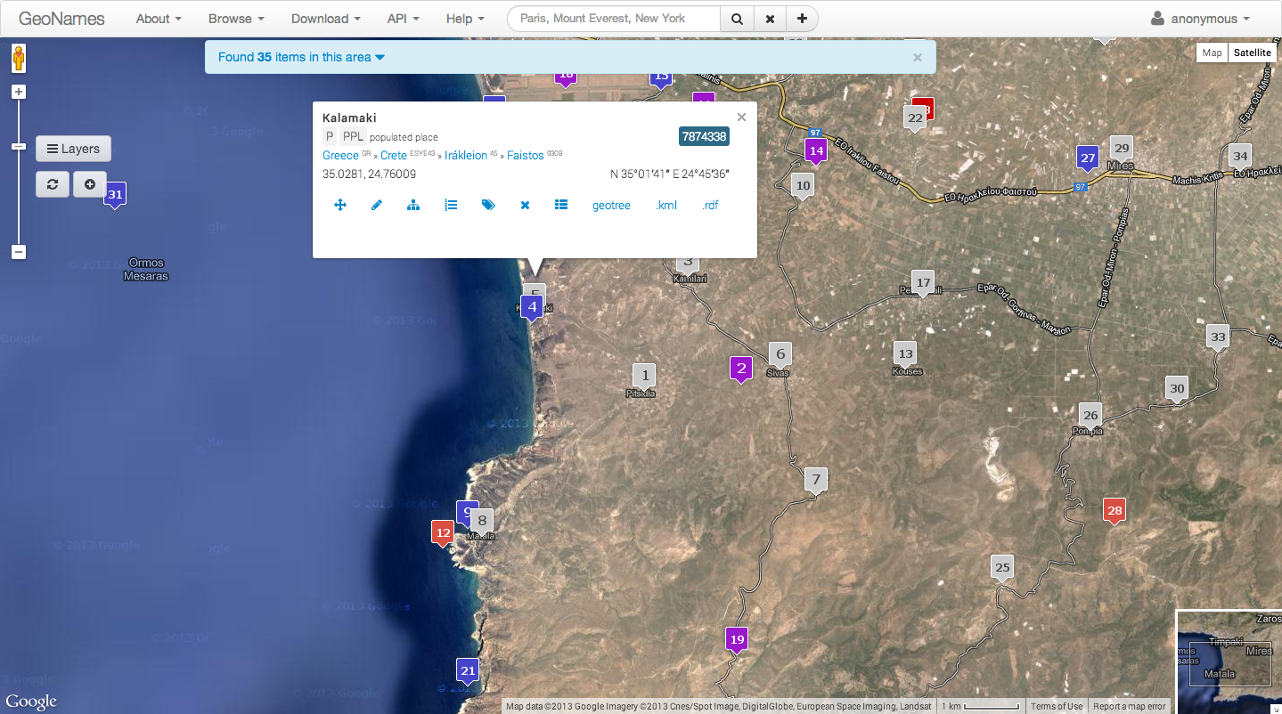
Geonames

Slide 26
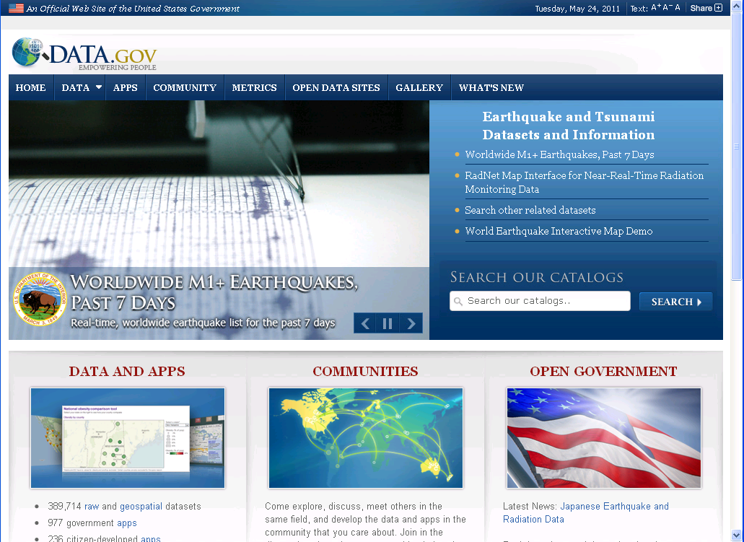
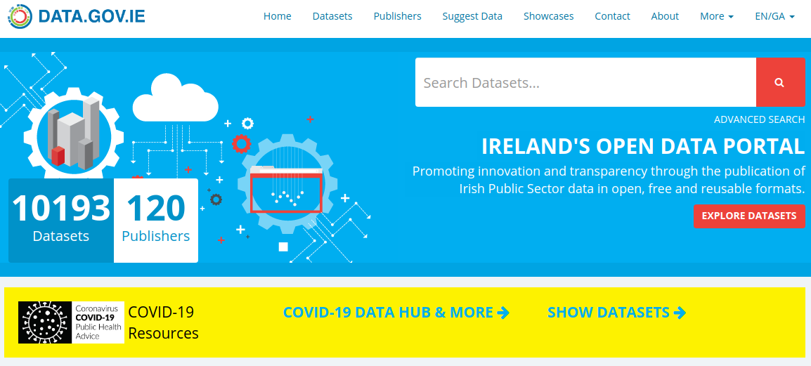
Government Data

Slide 27
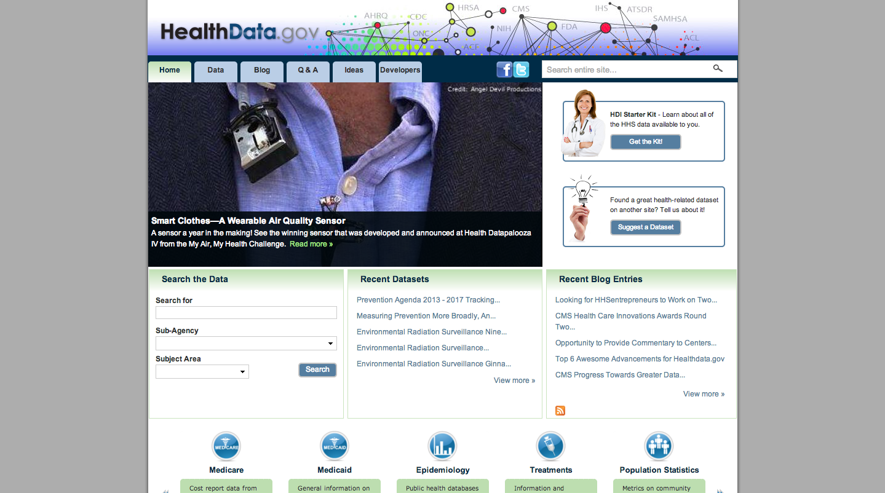
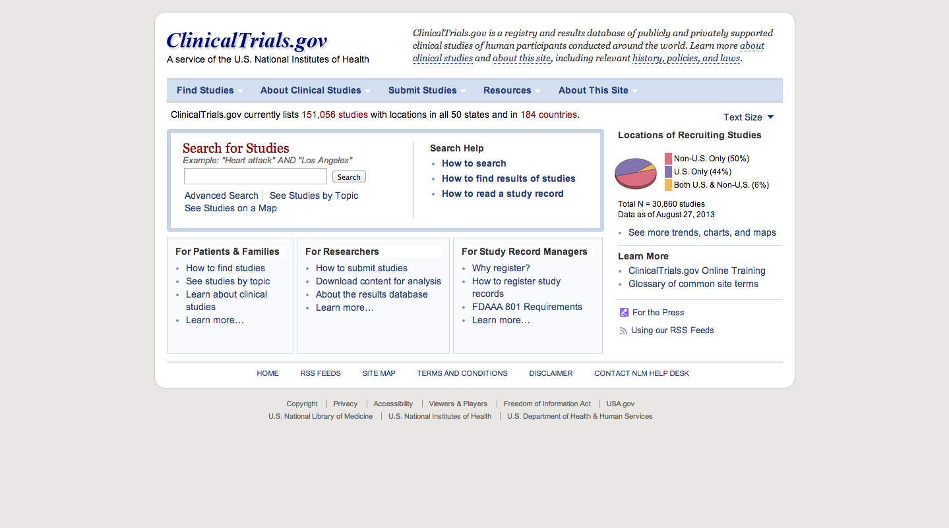
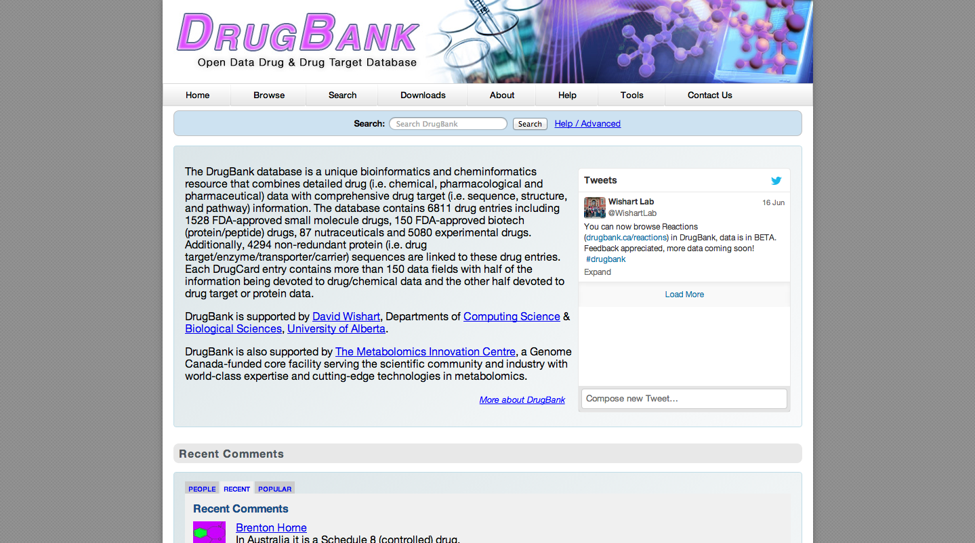
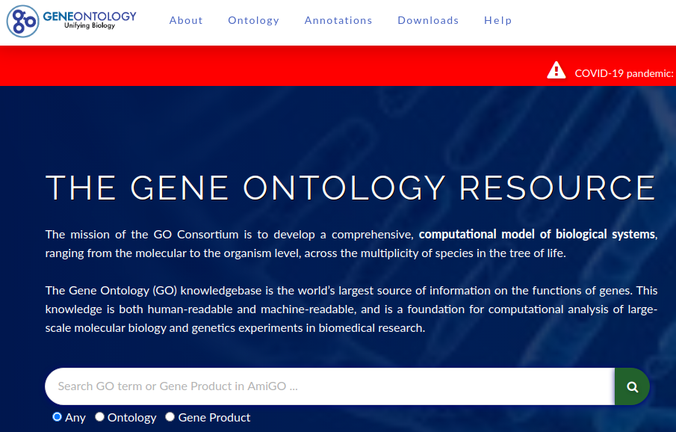
Life Sciences

Slide 28
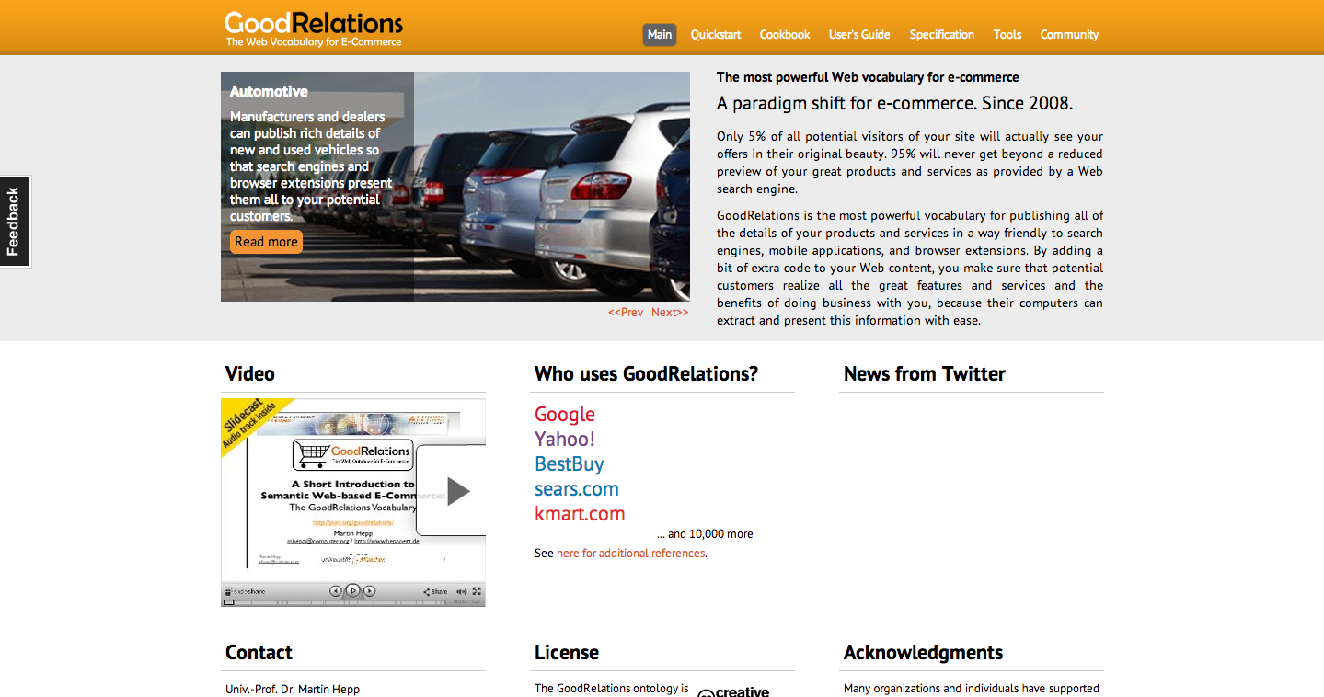
E-Commerce

Slide 29
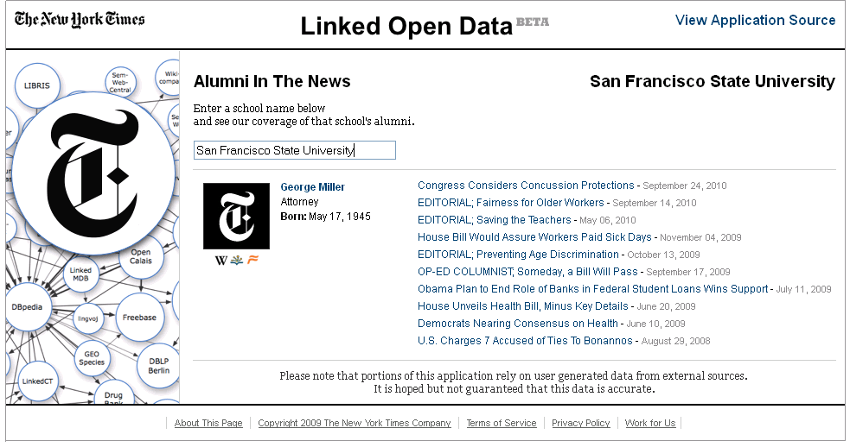
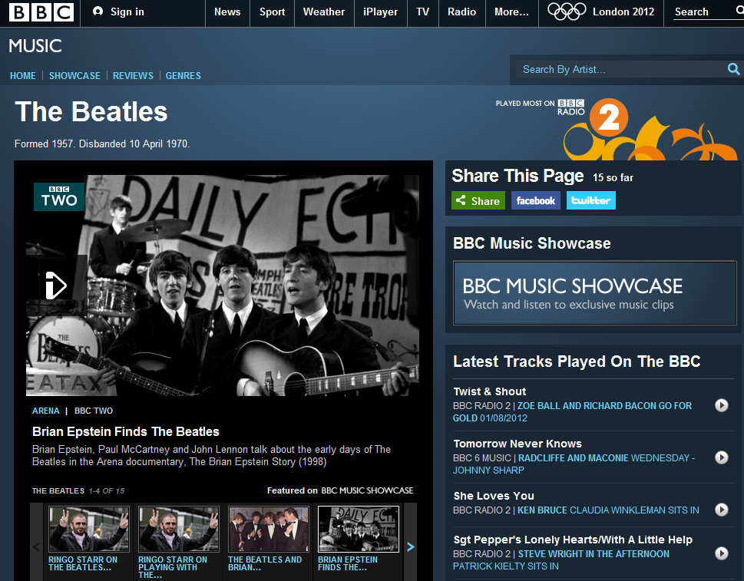
Media
http://data.nytimes.com/schools/schools.html

Slide 30

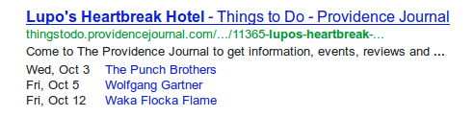
Schema.org
Used for search engine optimization
<div itemscope itemtype="http://schema.org/Movie">
<h1 itemprop="name">Avatar</h1>
<div itemprop="director" itemscope itemtype="http://schema.org/Person">
Director: <span itemprop="name">James Cameron</span>
(born <time itemprop="birthDate" datetime="1954-08-16">August 16, 1954</time>)
</div>
<span itemprop="genre">Science fiction</span>
<a href="../movies/avatar-theatrical-trailer.html" itemprop="trailer">Trailer</a>
</div>

Slide 31
But...

Slide 32
Discussion
What do you think are challenges for linked data?

Slide 33
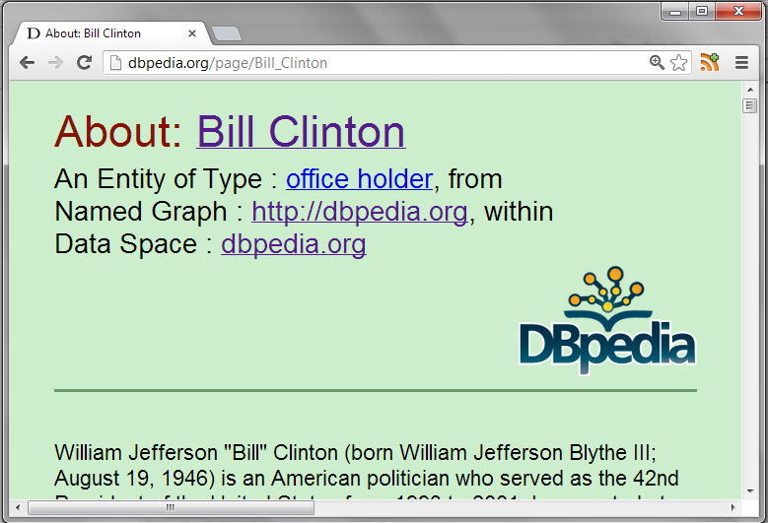
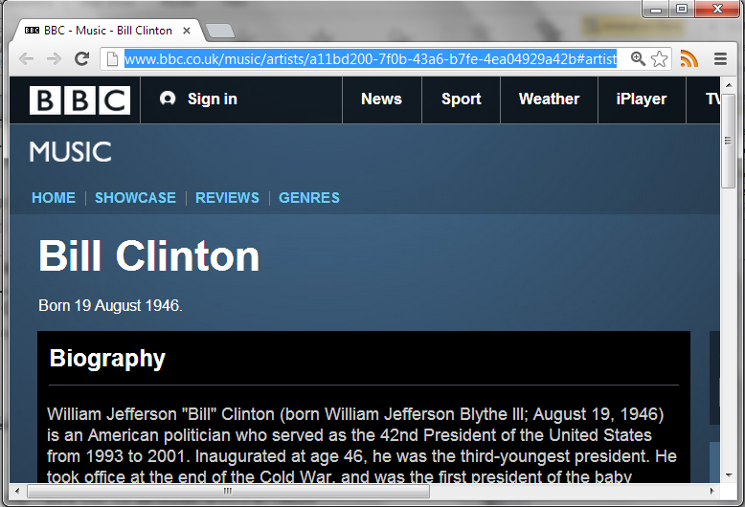
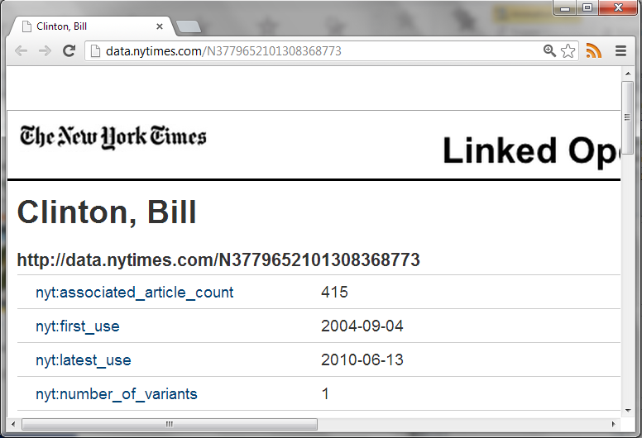
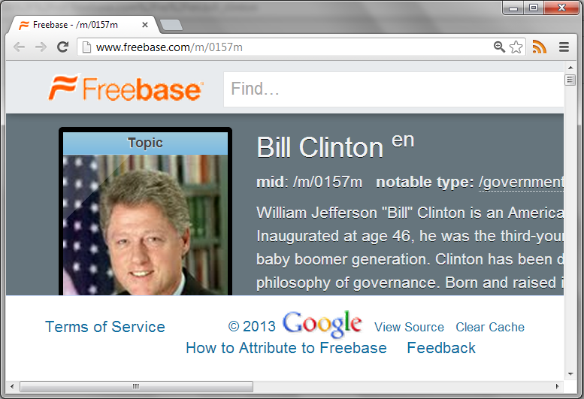
Integration
http://dbpedia.org/resource/Bill_Clinton
http://rdf.freebase.com/ns/en.bill_clinton
http://data.nytimes.com/clinton_bill_per
http://www.bbc.co.uk/music/artists/…

Slide 34
Many access methods
Dereferencing:
Look up a URI, get an RDF document
Dumps:
Get all data in an archive
SPARQL (1.0? 1.1?) Queries:
Send a query, get the answers

Slide 35
Dereferencing
What to put in document
Triples using the query URL?
Backlinks?
Too much information?

Slide 36
Dumps
Very large
Can take a long time to download and decompress
How do you find a dump for a given URL?
No standards!

Slide 37
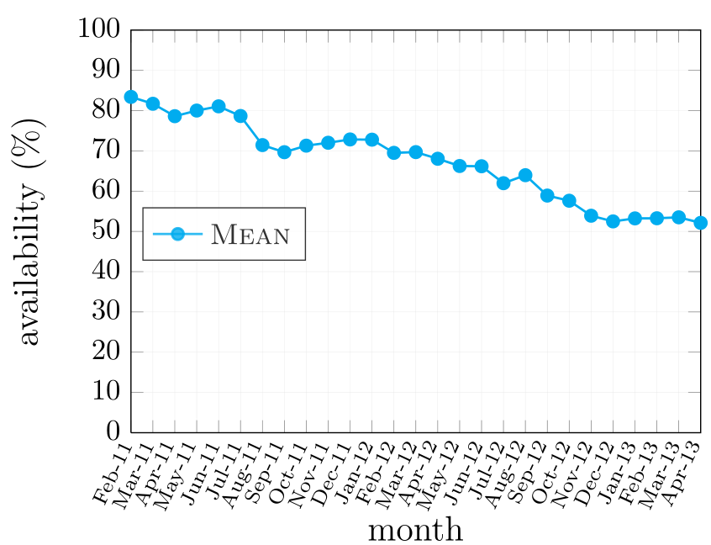
SPARQL
Keeping a SPARQL endpoint going is hard.
Queries can be very expensive (what about malicious users?)
No support for partial results, timeouts, exception handling, pagination

Slide 38

Graph patterns
Limited SPARQL querying, only certain patterns
Most common implementation is Linked Data Fragments
More work on client side ⇒ easier, more robust server implementation
Notes:
NEW

Slide 39
Access trade-offs
Dumps
Fragments
More bandwidth,
less CPU
Pages
SPARQL
Less bandwidth,
more CPU
Notes:
NEW

Slide 40
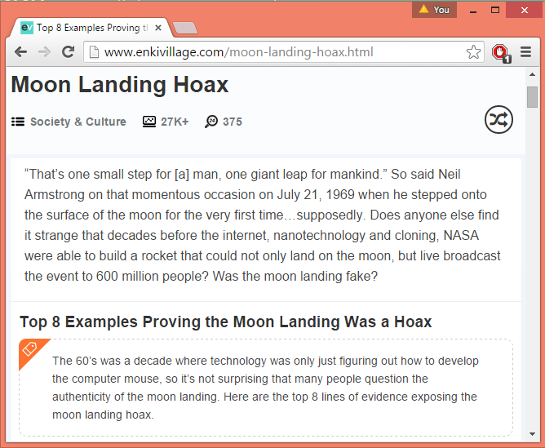
Web is full of lies
How to distinguish between fake facts in RDF
How to get provenance?
What about reasoning?

Slide 41
Some Open Research Questions
How to efficiently access Linked Data?
How to automatically link datasets?
How to reason over Web data?
How to verify/measure quality?
How to deal with deceit?
How to make it all “easy to use”?
How best to model vocabularies for reuse?
How to convert legacy data to Linked Data?

Slide 42
Discussion
Can you think of any solutions to these problems?

Slide 43
Summary
4 principles/5 stars
Lots of datasets :)
Lots of issues :(

